Slide 1
COE-IOT- Introduction (3rd Sem)
Jagdeesh Patil S

Slide 2
Enabling Technologies
Definition of IOT from ITU:
“Global infrastructure for the information society enabling advanced services by interconnecting, physical and virtual things based on existing and evolving interoperable information and communication technologies”
Internet
Sensor
1
IOT-Device
(Battery or Energy Harvested)
Sensor
Gateway
(Ex: Ubuntu OS)
Edge Device
N
IOT-Devices
(Battery or Energy Harvested)
Command
Max Value
Min Value
Average Value
Data

Slide 3
1
2
Edge Device
Storage (Cloud)
3
4
Analytics
Visualization
1
IOT
Device
Ambient Temp
Humidity
Embedded Code
Embedded OS
Remote
User
Analytics + Storage
N
IOT
Devices
Command
Data
Data
Analytics
Command
Data
Internet
Analytics
Gateway
Command

Slide 4
Sensors
Definition: “A sensor Detects (senses) changes in the ambient conditions or in the state of another device or a system and forwards or processes this information in a certain manner”
“A device which detects or measures a physical property and records, indicates, or otherwise responds to it” – Oxford Dictionary
They perform some input functions by sensing or feeling the physical changes in the characteristics of a in response to a stimuli
Ex: Heat is converted to electrical signals in a temperature sensor or atmospheric pressure is converted to electric signals in a barometer

Slide 5
Transducer
Transducers converts one form of energy into another form of energy
Example: in a sound system, a microphone (input device) converts sound waves into electrical signals for an amplifier to amplify (a process) and a loudspeaker (output device) converts these electrical signals back into sound waves
Sensors Vs Transducer
The word “Transducer” is a collective term used for both Sensors which can be used to sense a wide range of different energy forms such as movement, electrical signals, radiant energy, thermal or magnetic energy etc.., Actuators which can be used to switch voltages and currents

Slide 6
Sensor Features
It is only sensitive to the measured property (ex: A temperature sensor senses the ambient temperature of the environment, say room)
It is insensitive to any other property likely to be encountered in the application(ex: A temperature sensor does not about light or pressure while sensing the temperature)
It does not influence the measured property (ex: Measuring the temperature does not increase or reduce the temperature)
Sensor Resolution
The resolution of the sensor is the smallest change it can detect in the quantity that it is measuring
The resolution of the sensor with a digital output is usually the smallest resolution the digital output it is capable of processing.
The more is the resolution of a sensor the more accurate is its precision
The sensor accuracy does not depend on its resolution

Slide 7
Sensor Classes
Analog Sensors:
Analog sensors produce continuous output signal or output which is generally proportional to the quantity being measured
Physical quantities such as Temperature, Speed, Pressure, Displacement, Strain etc.. Are all analogue quantities as they tend to be continuous in nature
Ex: The temperature of liquid water can be measured using thermometer or thermocouple (e.g. in geysers) which continuously responds to temperature changes as liquid is heated up or cooled down
Based on Output
Based on Data Type
Analog
Scalar
Vector / Multimedia
Digital

Slide 8
Digital Sensors:
Analog sensors produce continuous output signal or output which is generally proportional to the quantity being measured
Physical quantities such as Temperature, Speed, Pressure, Displacement, Strain etc.. Are all analogue quantities as they tend to be continuous in nature
Ex: The temperature of liquid water can be measured using thermometer or thermocouple (e.g. in geysers) which continuously responds to temperature changes as liquid is heated up or cooled down
Scalar Sensors:
Scalar sensors produce output signal or voltage which is generally proportional to the magnitude of the quantity being measured
Physical quantities such as temperature, colour, pressure, strain etc. are all scalar quantities as only their magnitude is sufficient to convey an information
Ex: The temperature of a room can be measured using a thermometer or thermocouple, which responds temperature changes irrespective of orientation of the sensor or its direction

Slide 9
Vector Sensors
Vector sensors produce output signal or voltage which is generally proportional to the magnitude, direction as well as the orientation of the quantity being measured
Physical quantities such as sound, image velocity, acceleration, orientation, etc. are all vector quantities, as only their magnitude is not sufficient to convey the complete information
Ex: the acceleration of a body can be measured using an accelerometer, which gives the components of the acceleration of the body with respect to the x, y, z coordinate axis

Slide 10
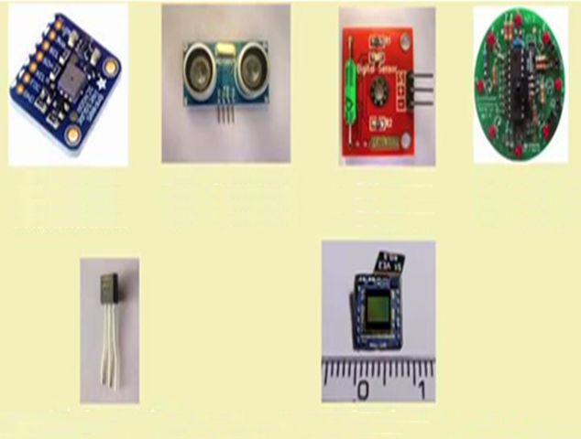
Sensor Types
Light
Light Dependent resistor
Photo-diode
Temperature
Thermocouple
Thermistor
Force
Strain-Gauge
Pressure switch
Pressure Sensor Ultrasonic Distance Sensor Tilt Sensor Infrared Motion Sensor
Position
Potentiometers, Encoders
Opto-coupler
Speed
Reflective/Opto-coupler
Doppler effect sensor
Sound
Carbon Microphone
Piezoelectric Crystal
Chemical
Liquid Chemical sensor
Gaseous chemical sensor
Analog Temperature Sensor Camera Sensor

Slide 11
Sensorial deviations
Since the range of output signal is always limited, the output signal will eventually reach a minimum or maximum, when the measured property exceeds the limits. The full scale range of a sensor defines the maximum and minimum values of the measured property
The sensitivity of a sensor under real conditions may differ from the value specified. This is called a sensitivity error
If the output signal differs from the correct value by a constant , the sensor has an offset error or bias
Non Linearity
Non Linearity is deviation from a sensor transfer function (TF) from a straight line transfer function
This is defined by the amount of the output differs from the ideal transfer behaviour over the full range of the sensor, which is denoted as the percentage of the full range
Most sensor have linear behaviour
If the output signal slowly changes independent of the measured property, this is defined as drift. Long time drift over months or years is caused by physical changes in the sensor
Noise is the random variation of the signal that varies witrh time

Slide 12
Hysteresis Error
A Hysteresis error causes the sensor output value to vary depending on the sensor’s previous input value
Is the sensor’s out is different depending on whether a specific input value is reached by increasing or decreasing the input , then the sensor has the hysteresis error
The present reading depend on the past input values.
Typically in analogue sensors , magnetic sensors, heating of metal stripes
Other Errors
If the sensor has a digital output , the output is essentially an approximation of the measured property, this error is quantization error
If the signal monitored digitally, the sampling frequency can cause a dynamic error , or if the input variable or added noise changes periodically at a frequency proportional to the multiple to the sampling frequency , aliasing error may occur
The sensor may to some extent be sensitive to properties other than property being measured . Ex: most sensors are influenced by the temperature of their environment

Slide 13
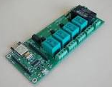
Actuator
An actuator is a component of a machine or a system that moves or controls the mechanism of the system
A actuator is the mechanism by which a control system acts upon the environment
An actuator requires a control signal and a source of energy

Slide 14
Upon receiving the control system, the actuator responds by converting the energy into mechanical motion
The control system can be simple ( a fixed mechanical or electronic system ), software based (Ex: a printer driver, robot, control system), a human, or any other input
Current
Voltage
Pneumatic (Air)
Hydraulic (fluid)
Manual
Driver (Ex:
Crank Shaft)
Mechanical
Actuator
Pressure
Electric
Control Signal

Slide 15
Actuator Types
Hydraulic
Pneumatic
Electric
Thermal/Magnetic
Mechanical

Slide 16
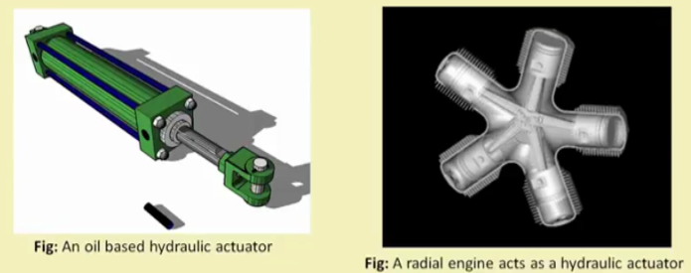
Hydraulic Actuators:
A hydraulic actuator consists of a cylinder or fluid motor that uses hydraulic power to facilitate mechanical operation
The mechanical motion is converted to linear, rotary or oscillatory motion
Since liquids are nearly impossible to compress, a hydraulic actuator exerts considerable force
The actuator’s limited acceleration restricts its usage

Slide 17
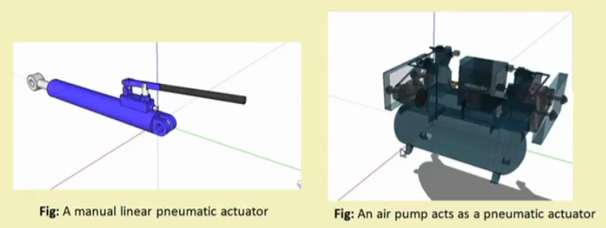
Pneumatic Actuators:
A pneumatic actuator converts energy formed by vacuum or compressed air at high pressure into either linear or rotary motion
Pneumatic rack and pinion actuators are used for valve control of water pipes
Pneumatic energy quickly responds to starting and stopping signals
The power source need not be stored in reserve for operation
Pneumatic actuators enable large forces to be produced from relatively small pressure changes (ex: pneumatic brakes are very responsive to small changes in pressure applied by the driver) and it is responsive for converting pressure into force

Slide 18
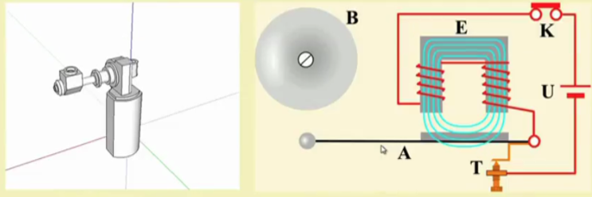
Electric Actuators:
An Electric actuator is generally powered by a motor that converts electric energy into mechanical one
The electrical energy is used to actuate equipment such as solenoid valves which control the flow of water in pipes in response to electric energy
Considered as one of the cheapest, cleanest and speedy actuator types available
A motor drive-based
rotary actuator
Solenoid based electric
Bell ringing mechanism

Slide 19
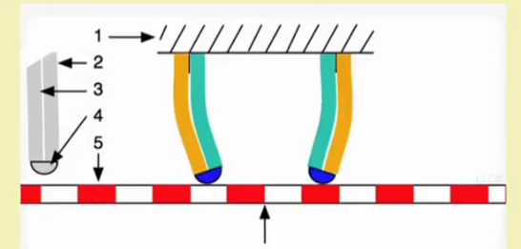
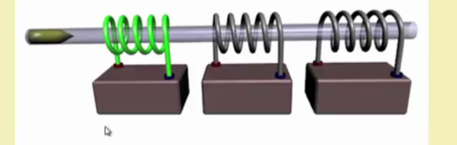
Thermal or magnetic actuators:
These can be actuated by Appling thermal or magnetics energy
They tend to be compact, light weight, economical, and with high power density
These actuators use shape memory materials (SMMs) , such as shape memory alloys(SMAs) or magnetic shape memory alloys (MSMAs)
Some popular manufacturers of these devices are Finnish Modtis Inc. and American Dynalloy
A coil gun works on principle of magnetic actuation
A peizo motor using SMA

Slide 20
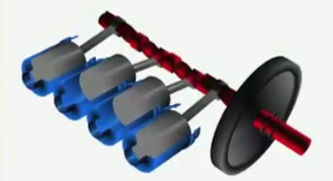
Mechanical actuators:
A mechanical actuator converts rotary motion into linear motion to excecute some movement
It involves gears , rails, pulleys, chains, and other devices to operate ( Ex: Rack and pinion)
A crank shaft acting as a mechanical actuator

Slide 21
Soft Actuators:
Soft actuators (Ex: Polymer based ) are designed to handle fragile objects like fruit harvesting in agriculture or manipulating the internal organs of in bio-medicine
They typically address the challenging tasks in robotics
Soft actuators produce flexible motion due to the integration of microscopic changes at the molecular level into macroscopic deformation of the actuator materials
Shape memory Polymers:
Shape memory Polymer (SMP) actuator function similar to our muscles, even providing a response to a range of stimuli such as light, electrical, magnetic, heat, pH, and moisture changes
SMP exhibits surprising features such as low density , high strain recovery , biocompatibility , and bio degradability

Slide 22
IOT Networking: IOT Components:
Device (The Thing)
Local Network
Internet
Backend Services
Applications

Slide 23
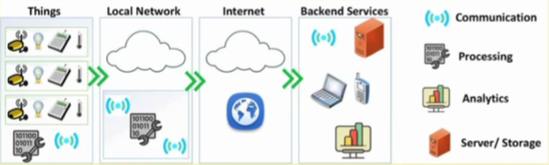

Slide 24
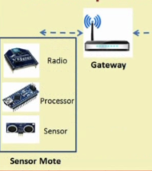
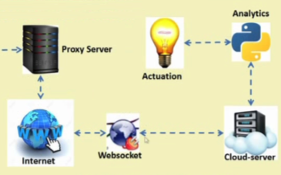
Functional Component of IOT:
Components for interaction and communication with other IOT devices
Components for processing and analysis of operation
Components for internet integration
Components for handling Web Services of applications
Components to integrate application services
User interface access to IOT
An Example of Implementation:

Slide 25
IOT Interdependencies:
Embedded Devices
Sensors
Applications
Virtual Machines
Actuators
Real-time Kernel
Power Management
Web
HTTP Client
Radios
6LowPAN
Bluetooth
Zigbee
MQTT Client
WiFi
Ethernet
LoR Wi-Fi
CoAP Client

Slide 26
IOT Service Oriented Architecture
Application
Frontend
Contract
Contract
Application
API
Interface Layer
Service Bus
Service
Divisions
Service Integration
Service Integration
Service
Repository
Service bus
Service Layer
Business Logic
Internet
Mobile Network
Social Network
Databases
WLAN
Network Layer
Data Sensing and acquisition Protocols
Sensing Layer
RFID Tags
Intelligent Sensors
RFID Readers
BLE Devices
WSNs

Slide 27
IOT Categories:
Industrial IOT
IOT device connects to an IP network and global internet
Communication between the nodes done using regular as well as industry specific technologies
Consumer IOT
IOT device communicates within a locally networked device
Local communications is done via Bluetooth , Zigbee or WiFi
Generally limited to local communication by Gateway

Slide 28
IOT Gateways:
Software
Switching
Routing
Global Network
Local Network
Protocol Conversion
Firewall & VPN
Security
Processor

Slide 29
IOT and associated Technologies:
Big Data
SDN
Cloud
IOT
3G/4G/5G
Smart Grid
CPS
IOV
Tele
Medicine
M2M

Slide 30
Technical deviation from Regular Web
IOT Stack
Web Stack
Applications
Management
Web Applications
Binary, JSON
HTML, XML, JSON
MQTT, COAP, AMQP
HTML,DHCP, DNS, TLS/SSL
UDP, DTLS
TCP, UDP
IPV6
IPV6, IPV4,IPSec
6LowPAN
IEEE802.15.2 MAC
Ethernet, DSL, ISDN, Wireless LAN, Wi-Fi
IEEE802.15.4 PHY / Radio

Slide 31
Key Technologies of IOT:
Security Privacy
Future Internet
Knowledge Aggregation
Standards
Sensor Networks
Communication
Cloud Computing
Discovery Service
Nano Electronics
Embedded Systems
Software
System Integration

Slide 32
IOT Challenges:
Security
Scalability
Energy Efficiency
Bandwidth Management
Modelling and analysis
Interfacing
Interoperability
Data storage
Data Analytics
Complexity Management (Ex: SDN)

Slide 33
Functionality Based IOT Protocol Organisation
Data Protocols (MQTT, CoAP, AMQP)
Connectivity(6LowPAN)
Communication and Transport (Wi-Fi. Bluetooth, LPWAN
Discovery
Device Management
Semantic

Slide 34
MQTT
(Message Que Telemetry Transport)
ISO Standard (ISO/IEC PRF 20922)
It is publish-Subscriber based lightweight messaging protocol for user in conjunction with the TCP/IP
MQTT was introduced by IBM in 1999 and standardized by OASIS in 2013
Design to provide connectivity ( mostly embedded ) between application and middle-wares on one side and networks and communications on the other side
A message broker controls the publish – subscribe messaging pattern
A topic to which a client is subscribed is updated in the form of messages and distributed by the message broker
Designed for:
Remote connections
Limited bandwidth
Small-code footprint

Slide 35
MQTT Components
Publishers
Light weight sensors
Applications interested for sensor data
Subscribers
Connect Publishers and Subscribers
Classify sensor data into Topics
Brokers

Slide 36
MQTT Methods
Connect
Disconnect
Subscribe
Unsubscribe
Publish

Slide 37
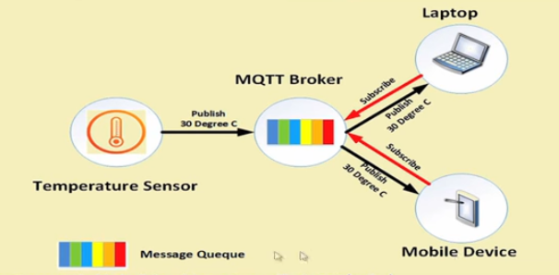

Slide 38
Communication:
The protocol uses publish/subscribe architecture (HTTP uses the request / response paradigm)
Publish/Subscribe is event-driven and enables messages to be pushed to the clients
The central communication point is the MQTT Broker , which is in charge of dispatching all messages between the senders and the rightful receivers
Each client that publishes a message to the broker , includes a topic into the message. The topic is the routing information for the broker
Each client that wants to receive the messages subscribes to a certain topic and the broker delivers all messages with the matching topic to client
Therefore the clients don’t have to know each other . They only communicate over topic
This architecture enables highly scalable solutions without dependencies between the data produces and the data consumers

Slide 39
MQTT was designed for environments with limited resources in mind especially about network access, thus this protocol has many features and options related to message delivery from server and clients. QoS or Quality of Service is the term for the 3 options for message delivery levels:
Level 0 (QoS = 0): At most once delivery. This means if the receiver missed the message it will not be sent again. In other words, the server (broker) sends the message and doesn’t expect an acknowledgment from the client.
Level 1 (QoS = 1): At least once delivery. This means that the broker keeps sending the message to the subscriber until it sense an acknowledgment from it. This may lead to receive the message more than once at the subscriber side .
Level 2 (QoS =2): Exactly once delivery. This level guarantees to deliver one message exactly to the subscriber.

Slide 40
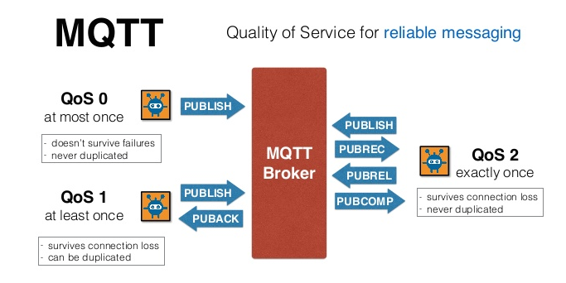

Slide 41
MQTT Topics
A topic is simple string that can have hierarchy levels , which are separated by a slash
A sample topic for sending temperature data of a living room could be “house/living-room/temperature”
On one hand the client (Ex: Mobile device) can subscribe to the exact topic or on other hand , it can use wildcard
The subscription to house/+/temperature would result in all messages sent to the previously mentioned topic house/living room/temperature , as well as any topic with the arbitrary value in the place of living room , such as house/kitchen/temperature
The plus sign is the single level wild card and only allows arbitrary values for one hierarchy
If more than one level needs to be subscribed , such as , the entire sub-tree, there is also a multi level wild card (#)
It allows to subscribe to all underlying hierarchy levels Ex: house/# is subscribing to all topics beginning with house

Slide 42
Applications:
Facebook Massagers uses MQTT for online chat
Amazon Web Services use Amazon IOT with MQTT
Microsoft Azure IOT hub uses MQTT as its main protocol for telemetry services
The EVERYTHING IOT Platform uses MQTT as an M2M protocol for millions of connected products
Adafruit launched a free MQTT cloud service for IOT experimenters called Adafruit IO

